Slide 1
The Economics behind a data breach
By: ManNY mand

Slide 2
What is a data breach?
Information (data) accessed without authorization
Costly expense that can damage lives
Some recent data breaches; Yahoo, Discover, Equifax

Slide 3
Who’s responsible for data breaches?
Script kiddies
State sponsored hackers
Organized Cyber-Crime groups

Slide 4
Economics & Data Breaches Intro
Global impact of a data breach averages $3.86 million USD
Each record stolen costs an organization about $148 USD
197 days to identify, 69 days to contain
References: Forbes (https://www.forbes.com/sites/niallmccarthy/2018/07/13/the-average-cost-of-a-data-breach-is-highest-in-the-u-s-infographic/#d32921c2f373)

Slide 5
Economics & Data Breaches Intro
Global impact of a data breach averages $3.86 million USD
Each record stolen costs an organization about $148 USD
197 days to identify, 69 days to contain
References: Forbes (https://www.forbes.com/sites/niallmccarthy/2018/07/13/the-average-cost-of-a-data-breach-is-highest-in-the-u-s-infographic/#d32921c2f373)

Slide 6
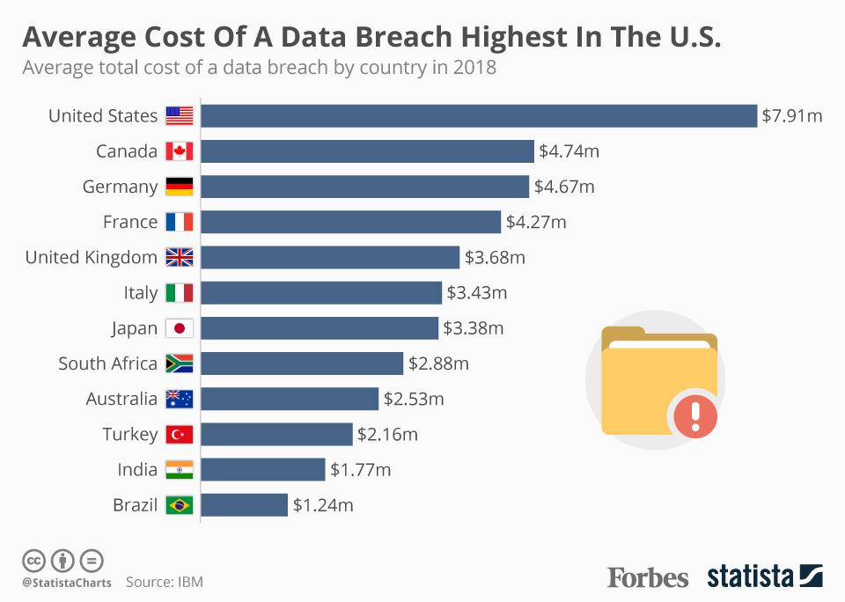
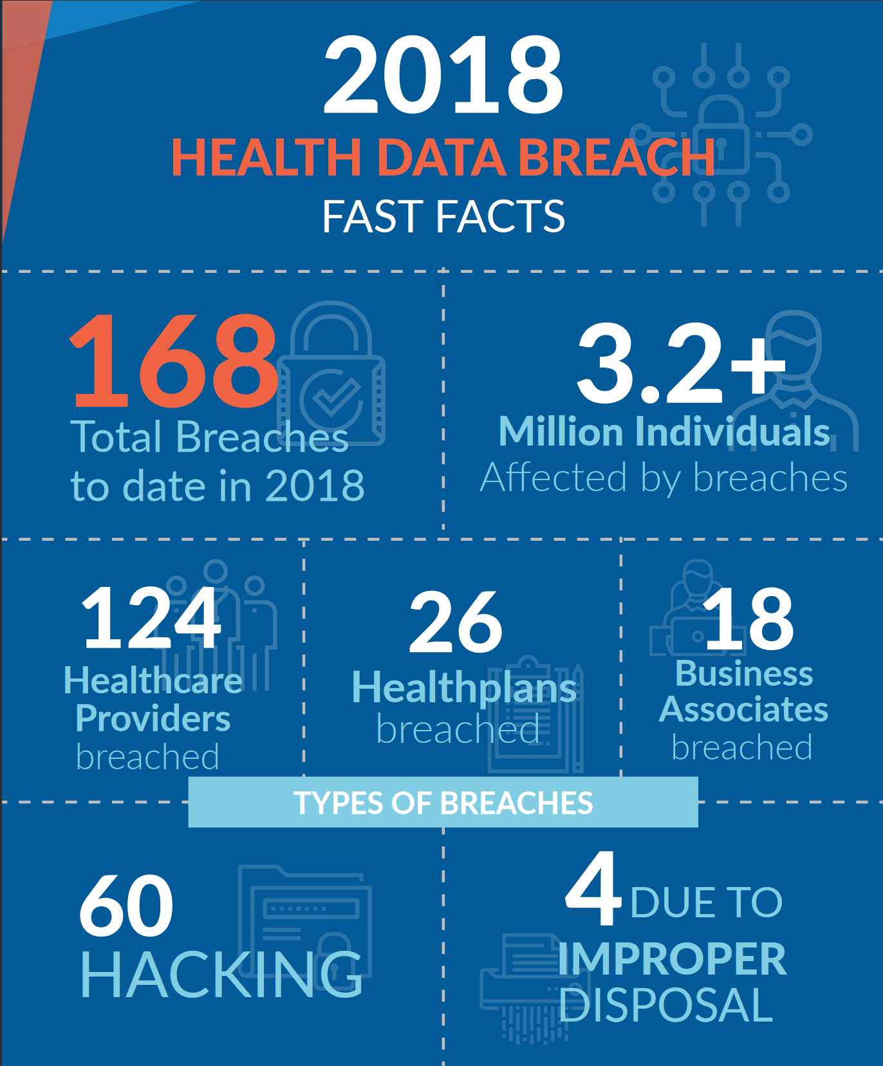
Economics & Data Breaches Intro

Slide 7
Why do they cost so much?
The amount of time to find the breach
Investments in technology to expediate response time
Lost/stolen records and their associated cost
Government fines

Slide 8
How a data breach can harm a business
Diminished reputation
Decreased competitive ability
Lost customer trust
Reduced revenue/lost sales

Slide 9
Preventing Data Breaches
Regular security audits
Software updates
Cybersecurity insurance
Dedicated security team

Slide 10
Questions

